Slide 1
Searching Algorithms
Data Structures & Algorithms
Dr. Sambit Bakshi
Dept. of CSE, NIT Rourkela

Slide 2
Searching
Finding the location of an given item in a collection of item

Slide 3
Linear Search with Array
2 | 7 | 9 | 12
1 | 2 | 3 | 4

Slide 4
Algorithm
[1] i = 1
[2] If K = A[i] , Print “Search is Successful” and Stop
[3] i = i + 1
[4] If (i <= n) then Go To Step [2]
[5] Else Print “Search is Unsuccessful” and Stop
[6] Exit

Slide 5
Complexity Of Linear Search Array
Case 1: Key matches with the first element
T(n) = Number of Comparison
T(n) = 1, Best Case = O(1)
Case 2: Key does not exist
T(n) = n, Worst Case = O(n)
Case 3: Key is present at any location with same probability
T(n) = (1+2+3+…+n)/n =(n+1)/2,
Average Case = O(n)

Slide 6
Linear Search with Linked List
A
B
C
∅
Head
Best Case
Worst Case
Average Case

Slide 7
Linear Search with Ordered List
5 | 7 | 9 | 10 | 13 | 56 | 76 | 82 | 110 | 112
1 | 2 | 3 | 4 | 5 | 6 | 7 | 8 | 9 | 10

Slide 8
Algorithm
[1] i = 1
[2] If K = A[i] , Print “Search is Successful” and Stop
[3] i = i + 1
[4] If (i <= n) and (A[i] <= K) then Go To Step [2]
[5] Else Print “Search is Unsuccessful” and Stop
[6] Exit

Slide 9
Complexity
Case 1: Key matches with the first element
T(n) = Number of Comparison
T(n) = 1, Best Case = O(1)
Case 2: Key does not exist
T(n) = n, Worst Case = O(n)
Case 3: Key is present at any location
T(n) = (n+1)/2, Average Case = O(n)

Slide 10
Binary Search
l |  |  |  |  |  |  |  |  | u
mid
mid = (l + u) /2
If K = A[mid] then done
l |  |  | u | mid
If K < A[mid]
u = mid -1
 |  |  |  | mid | l |  |  |  | u
If K > A[mid]
l = mid +1

Slide 11
Algorithm
[1] l =1, u =n
[2] while (l <= u) repeat steps 3 to 7
[3] mid = (l + u) / 2
[4] if K = A[mid] then print Successful and Stop
[5] if K < A[mid] then
[6] u = mid -1
[7] else l = mid + 1
[8] Print Unsuccessful and Exit

Slide 12
Example
K = 75
l = 1
u =8
1 | 2 | 3 | 4 | 5 | 6 | 7 | 8
15 | 25 | 35 | 45 | 65 | 75 | 85 | 95
l
u
1 | 2 | 3 | 4 | 5 | 6 | 7 | 8
15 | 25 | 35 | 45 | 65 | 75 | 85 | 95
l = 1
u =8
mid = 4
K = 75 > A[4]
l = 4 + 1
u
1 | 2 | 3 | 4 | 5 | 6 | 7 | 8
15 | 25 | 35 | 45 | 65 | 75 | 85 | 95
l = 5
u =8
mid = 6
K = 75 = A[6]
l = 4 + 1
u

Slide 13
Example
K = 55
l = 1
u =8
1 | 2 | 3 | 4 | 5 | 6 | 7 | 8
15 | 25 | 35 | 45 | 65 | 75 | 85 | 95
l
u
1 | 2 | 3 | 4 | 5 | 6 | 7 | 8
15 | 25 | 35 | 45 | 65 | 75 | 85 | 95
l = 1
u =8
mid = 4
K = 55 > A[4]
l = 4 + 1
u
1 | 2 | 3 | 4 | 5 | 6 | 7 | 8
15 | 25 | 35 | 45 | 65 | 75 | 85 | 95
l = 5
u =8
mid = 6
K = 55 < A[6]
l = 4 + 1
u= 6-1

Slide 14
1 | 2 | 3 | 4 | 5 | 6 | 7 | 8
15 | 25 | 35 | 45 | 65 | 75 | 85 | 95
l = 5
u =5
mid = 5
K = 55 < A[5]
l = 5
u= 5-1

Slide 15
Binary Search Complexity Analysis
T(n) = Number of Comparisons
Case 1: Key found in the first comparison
T(n) = 1, Best Case = O(1)

Slide 16
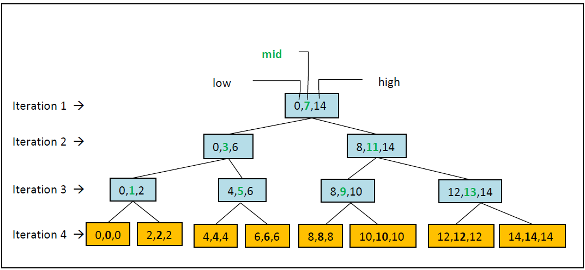

Slide 17
No. of iterations | Array Elements | No of Array Elements
1 | A[7] | 1
2 | A[3],A[11] | 2
3 | A[1],A[5],A[9],A[13] | 4
4 | A[0],A[2],A[4],A[6],A[8],A[10],A[12],A[14] | 8
. |  | .
. |  | .
k |  | 2^{k-1}
k : max no. of iterations
n : size of array
⇒ 1+2+4+…+2^{k-1} = n
⇒ 2^{k}-1=n
⇒ k = log₂(n+1)

Slide 18
Binary Search Complexity Analysis
Case 2: Key does not exist
T(n) = log₂(n+1)
Worst Case = O(log₂(n))

Slide 19
Case 3: Key is present at any location
No of Comparisons
4 | 3 | 4 | 2 | 4 | 3 | 4 | 1 | 4 | 3 | 4 | 2 | 4 | 3 | 4
5 | 15 | 25 | 35 | 45 | 55 | 65 | 75 | 85 | 95 | 105 | 115 | 125 | 135 | 145
Total. no. of comparisons, A = 1.1 + 2.2 + 3.4 + 4.8 + … + k.2^{k-1}
Which can be put as
1 + 2 + 4 + 8 + … + 2^{k-1}
+ 2 + 4 + 8 + … + 2^{k-1}
+ 4 + 8 + … + 2^{k-1}
+ 8 + … + 2^{k-1}
.
.
.
+ 2^{k-1}
⇒ A = (2^{k}-1) + (2^{k}-2) + (2^{k}-4) + (2^{k}-8) + … + (2^{k}-2^{k-1})

Slide 20
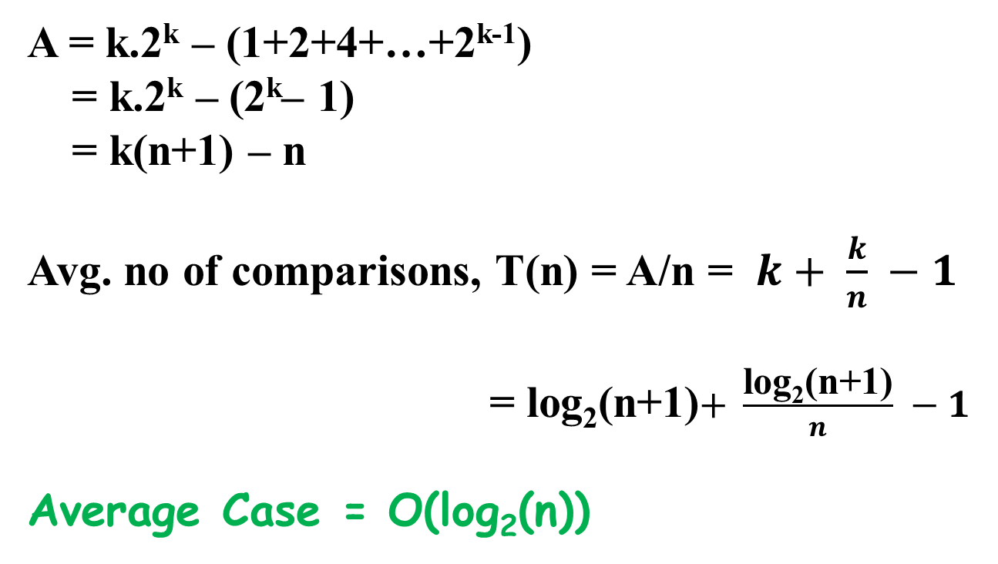
A = k.2^{k} – (1+2+4+…+2^{k-1})
= k.2^{k} – (2^{k}– 1)
= k(n+1) – n
Avg. no of comparisons, T(n) = A/n = $k+ \frac{k}{n} −1$
= log₂(n+1)$+ \frac{\text{log}\text{2}\text{(}\text{n}\text{+1)}}{n} −1$
Average Case = O(log₂(n))

Slide 21
Fibonacci Search
F_{n} = F_{n – 1} + F_{n – 2} with F₀ = 0 and F₁ = 1
If we expand the nth Fibonacci number into the form of a recurrence tree, it results into a binary tree and we can term this as Fibonacci tree of order n.

Slide 22
In a Fibonacci tree, a node correspond to F_{i} the ith Fibonacci number
F_{i-1} is the left subtree
F_{i-2} is the right subtree
F_{i-1} and F_{i-2} are further expanded until F₀ and F_{1.}

Slide 23
Fibonacci Tree
F₆
c
F₅
c
F₄
c
c
F₂
F₄
F₃
c
c
F₃
F₃
c
F₂
c
c
c
F₁
F₀
c
F₂
c
c
F₁
F₂
c
F₁
c
F₁
c
F₂
c
c
F₀
F₁
c
F₁
c
F₀
F₁
c
F₀
c
c
c
F₁
F₀
A Fibonacci Tree of Order 6

Slide 24
Apply the following two rules to obtain the Fibonacci search tree of order n from a Fibonacci tree of order n
Rule 1: For all leaf nodes corresponding to F₁ and F_{0,} we denote them as external nodes and redraw them as squares, and the value of each external node is set to zero. Value of each node is replaced by its corresponding Fibonacci number.

Slide 25
Rule 2: For all nodes corresponding to F_{i} (i>=2), each of them as a Fibonacci search tree of order i such that
(a) the root is F_{i}
(b) the left-subtree is a Fibonacci search tree of order i -1
(c) the right-subtree is a Fibonacci search tree of order i -2 with all numbers increased by F_{i}

Slide 26
Fibonacci Search Tree
F₆
c
F₅
c
F₄
c
c
F₂
F₄
F₃
c
c
F₃
F₃
c
F₂
0
0
c
c
F₂
c
0
0
F₂
F₂
c
0
0
0
0
0
0
0
0
0
Rule 1 applied to Fibonacci Tree of Order 6

Slide 27
Fibonacci Search Tree
8
c
5
c
3
c
c
1
3
2
c
c
2
2
c
1
0
0
c
c
1
c
0
0
1
1
c
0
0
0
0
0
0
0
0
0
Rule 1 applied to Fibonacci Tree of Order 6

Slide 28
Fibonacci Search Tree
8
c
5
c
11
c
c
12
3
7
c
c
10
2
c
6
7
12
c
c
4
c
10
11
1
9
c
2
5
6
3
0
4
8
9
1
Rule 2 applied to Fibonacci Tree of Order 6

Slide 29
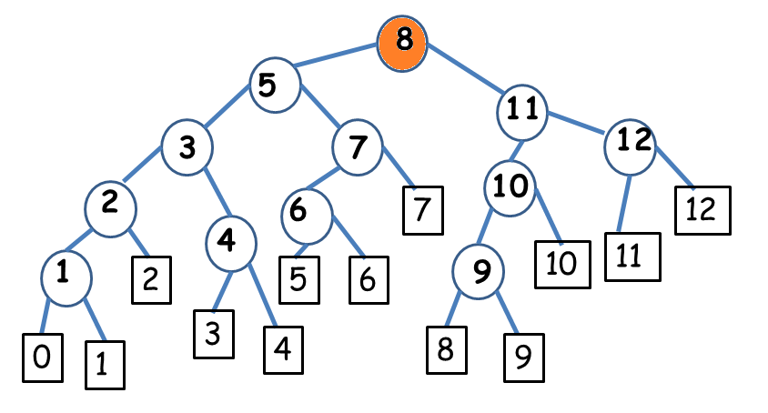
Evaluation #1

Slide 30
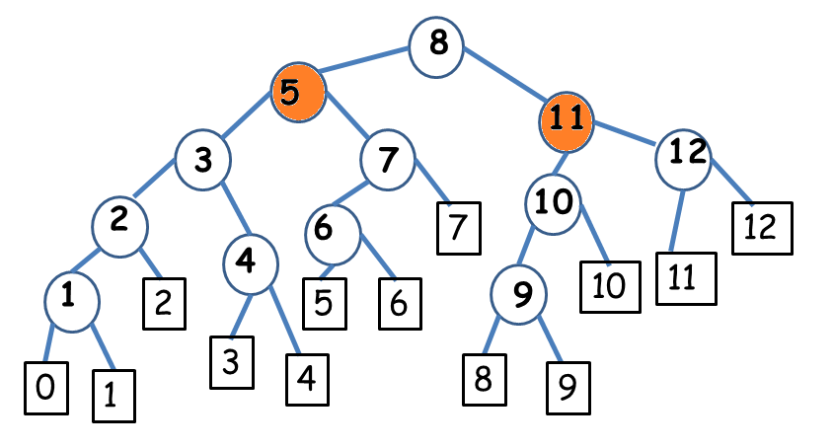
Evaluation #2

Slide 31
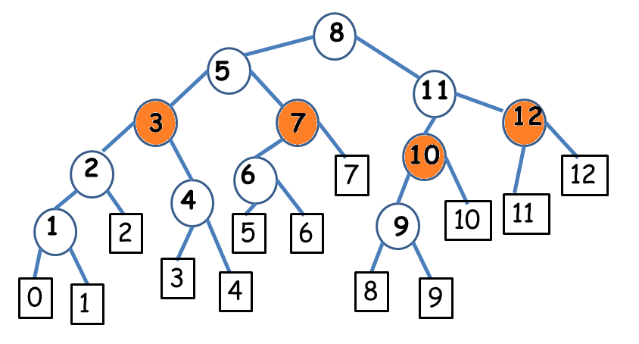
Evaluation #3

Slide 32
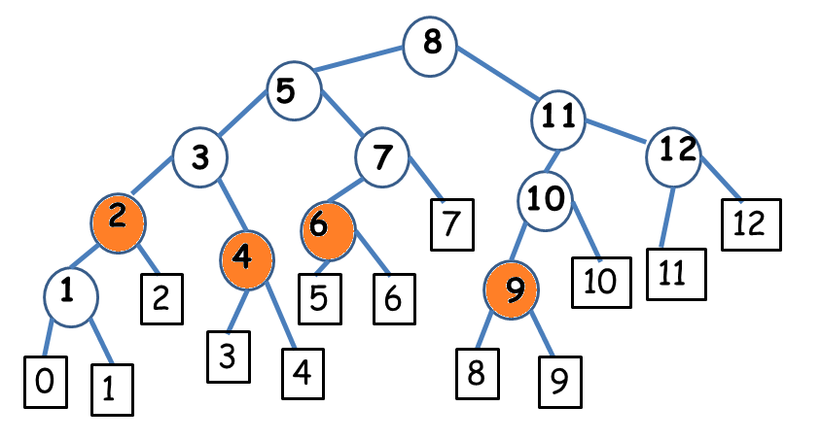
Evaluation #4

Slide 33
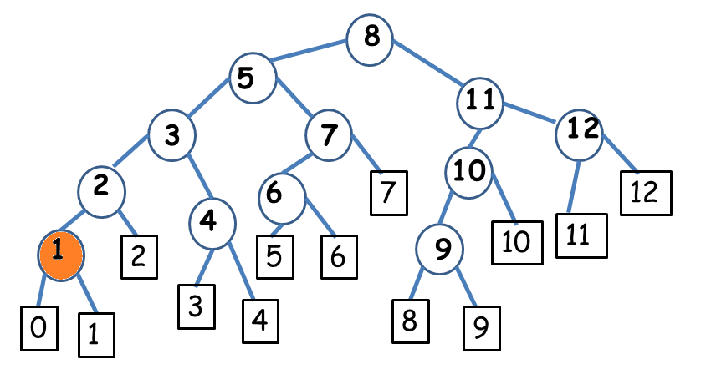
Evaluation #5

Slide 34
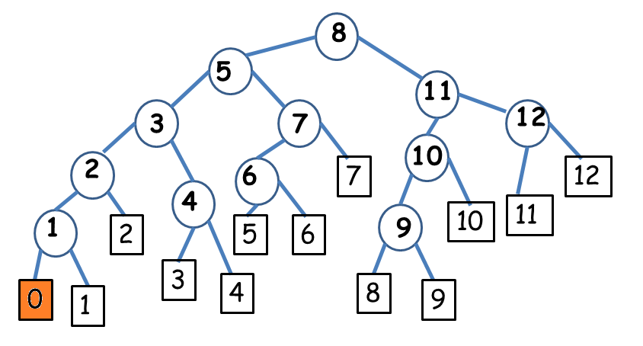
Evaluation #6

Slide 35
FibSearch(int arr[], int x, int n)
//Initialize fibonacci numbers
fibMMm2 = 0 // (m-2)'th Fibonacci No.
fibMMm1 = 1 // (m-1)'th Fibonacci No.
fibM = fibMMm2 + fibMMm1 // m'th Fibonacci
//fibM is going to store the smallest Fibonacci Number greater than or equal to n
while (fibM < n)
{
fibMMm2 = fibMMm1;
fibMMm1 = fibM;
fibM = fibMMm2 + fibMMm1;
}

Slide 36
// Marks the eliminated range from front
offset = -1;
// finding ‘i’ which is the comparison point
i = min(offset+fibMMm2, n-1)
/* If x is greater than the value at index fibMm2, Eliminate the subarray array from offset upto i */ if (arr[i] < x) { fibM = fibMMm1; fibMMm1 = fibMMm2; fibMMm2 = fibM - fibMMm1; offset = i; } | /* If x is less than the value at index fibMm2, Eliminate the subarray after i+1 */ else if (arr[i] > x) { fibM = fibMMm2; fibMMm1 = fibMMm1 - fibMMm2; fibMMm2 = fibM - fibMMm1; }
This goes iteratively until either arr[i] = x or fibM>1

Slide 37
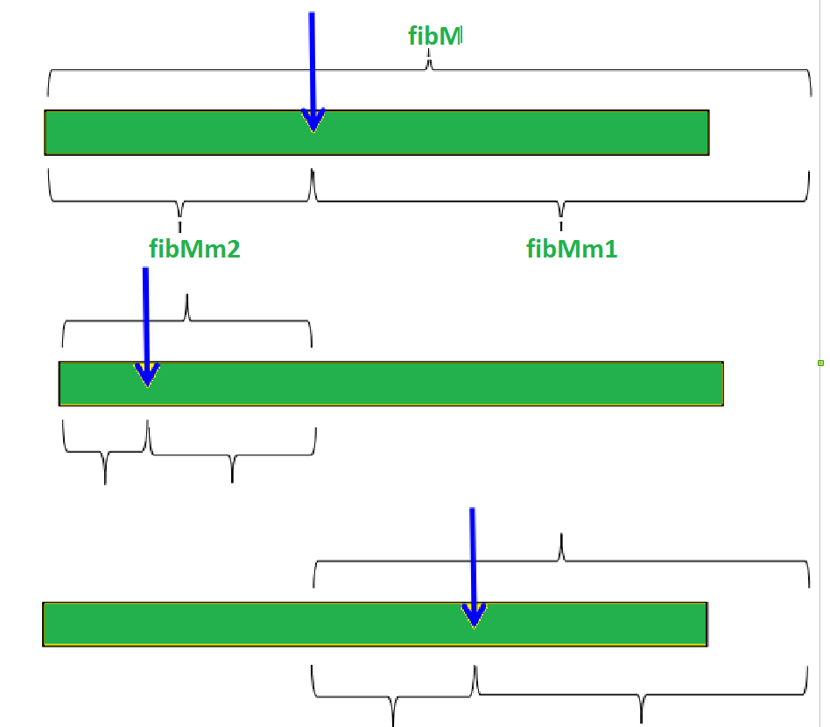

Slide 38
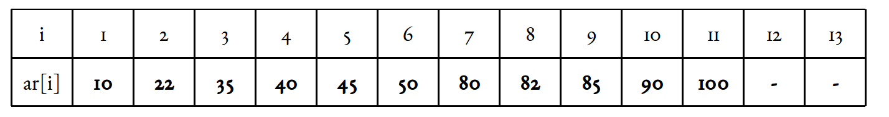
Illustration assumption:
1-based indexing. Target element x is 85. Length of array n = 11.

Slide 39
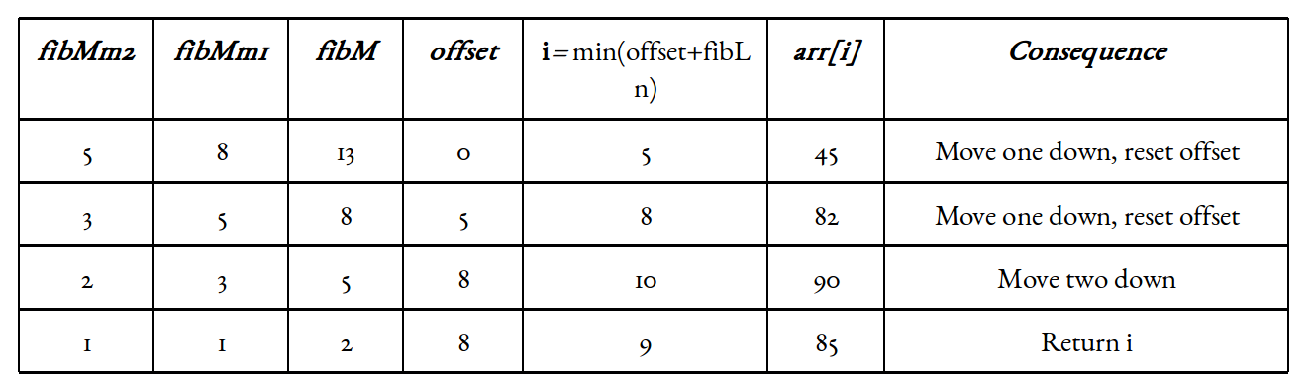

Slide 41


Slide 42
Algorithm
Elements are in sorted order. Number of elements n is related to a perfect Fibonacci number F_{k+1} such that F_{k+1} = n+1

Slide 43
[1] i = F_{k}
[2] p = F_{k-1} , q = F_{k-2}
[3] If ( K < K_{i} ) then
[4] If (q==0) then Print “unsuccessful and exit”
[5] Else i = i – q, p_{old} = p, p =q, q =p_{old} – q
[6] Goto step 3

Slide 44
[7] If (K > K_{i} ) then
[8] If (p ==1) then Print “Unsuccessful and Exit”
[9] Else i = i + q, p = p-q, q=q-p
[10] Goto step 3
[11] If ( k == K_{i} ) then Print “Successful at ith location”
[12] Stop

Slide 45
Example
1 | 2 | 3 | 4 | 5 | 6 | 7 | 8 | 9 | 10 | 11 | 12
15 | 20 | 25 | 30 | 35 | 40 | 45 | 50 | 65 | 75 | 85 | 95
K = 25
Initialization: i = F_{k} = 8, p = F_{k-1} = 5, q = F_{k-2} = 3
Iteration 1;
K₈ = A[8] = 50, K < K₈ , q == 3
i = i –q = 8 -3 = 5, p_{old} = p =5
p=q= 3, q = p_{old} – q = 5-3 = 2
Iteration 2;
K₅ = A[5] = 35, K < K₅ , q == 2
i = i –q = 5 -2 = 3, p_{old} = p =3
p=q= 2, q = p_{old} – q = 3-2 = 1

Slide 46
1 | 2 | 3 | 4 | 5 | 6 | 7 | 8 | 9 | 10 | 11 | 12
15 | 20 | 25 | 30 | 35 | 40 | 45 | 50 | 65 | 75 | 85 | 95
Iteration 2;
K₃ = A[3] = 25, K = K₃
_{Search is successful}

Slide 47
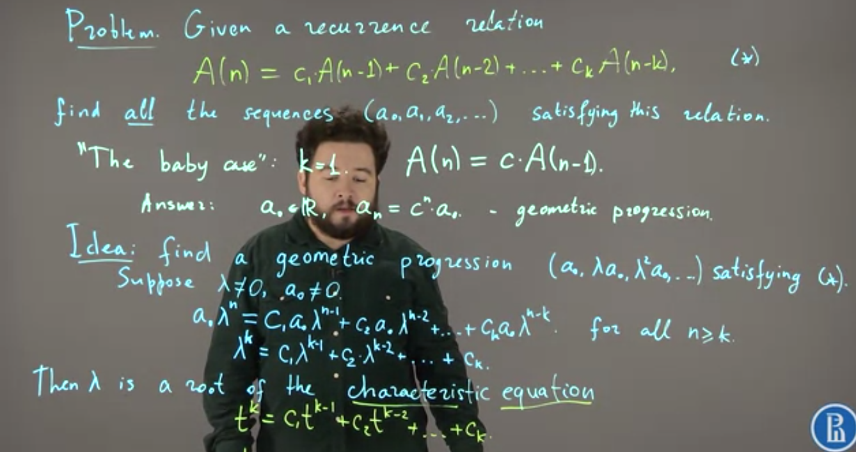
Finding time complexity of Fibonacci search

Slide 48
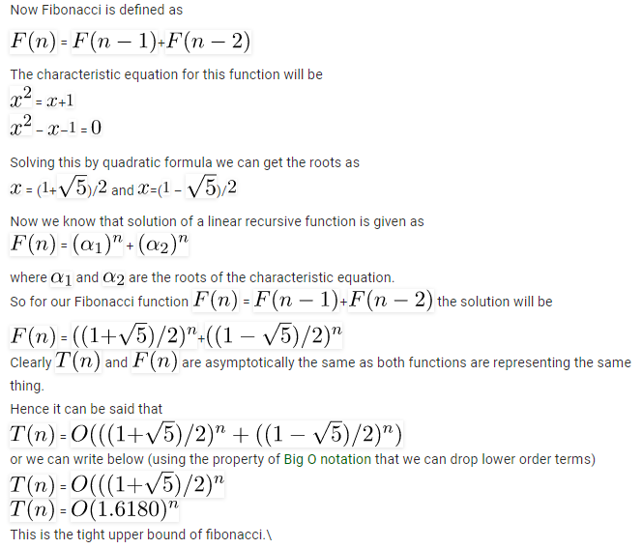
Finding time complexity of Fibonacci search

Slide 49
Comparison of Fibonacci search with binary search
Fibonacci Search divides given array in unequal parts
Binary Search uses division operator to divide range. Fibonacci Search doesn’t use /, but uses + and -. The division operator may be costly on some CPUs.
Fibonacci Search examines relatively closer elements in subsequent steps. So when input array is big that cannot fit in CPU cache or even in RAM, Fibonacci Search can be useful.

